Slide 1

Investigating forest-dependent salamander species in disturbed landscapes in the western Oregon Cascades
Jasmine Williamson

Slide 2
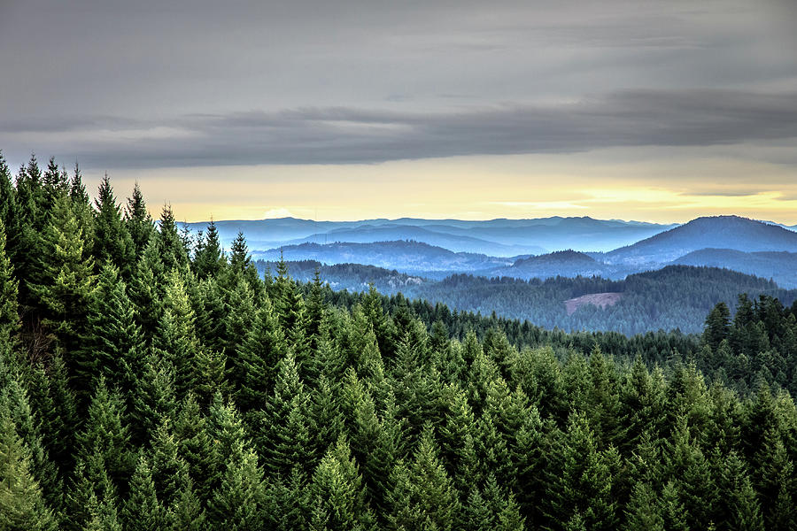
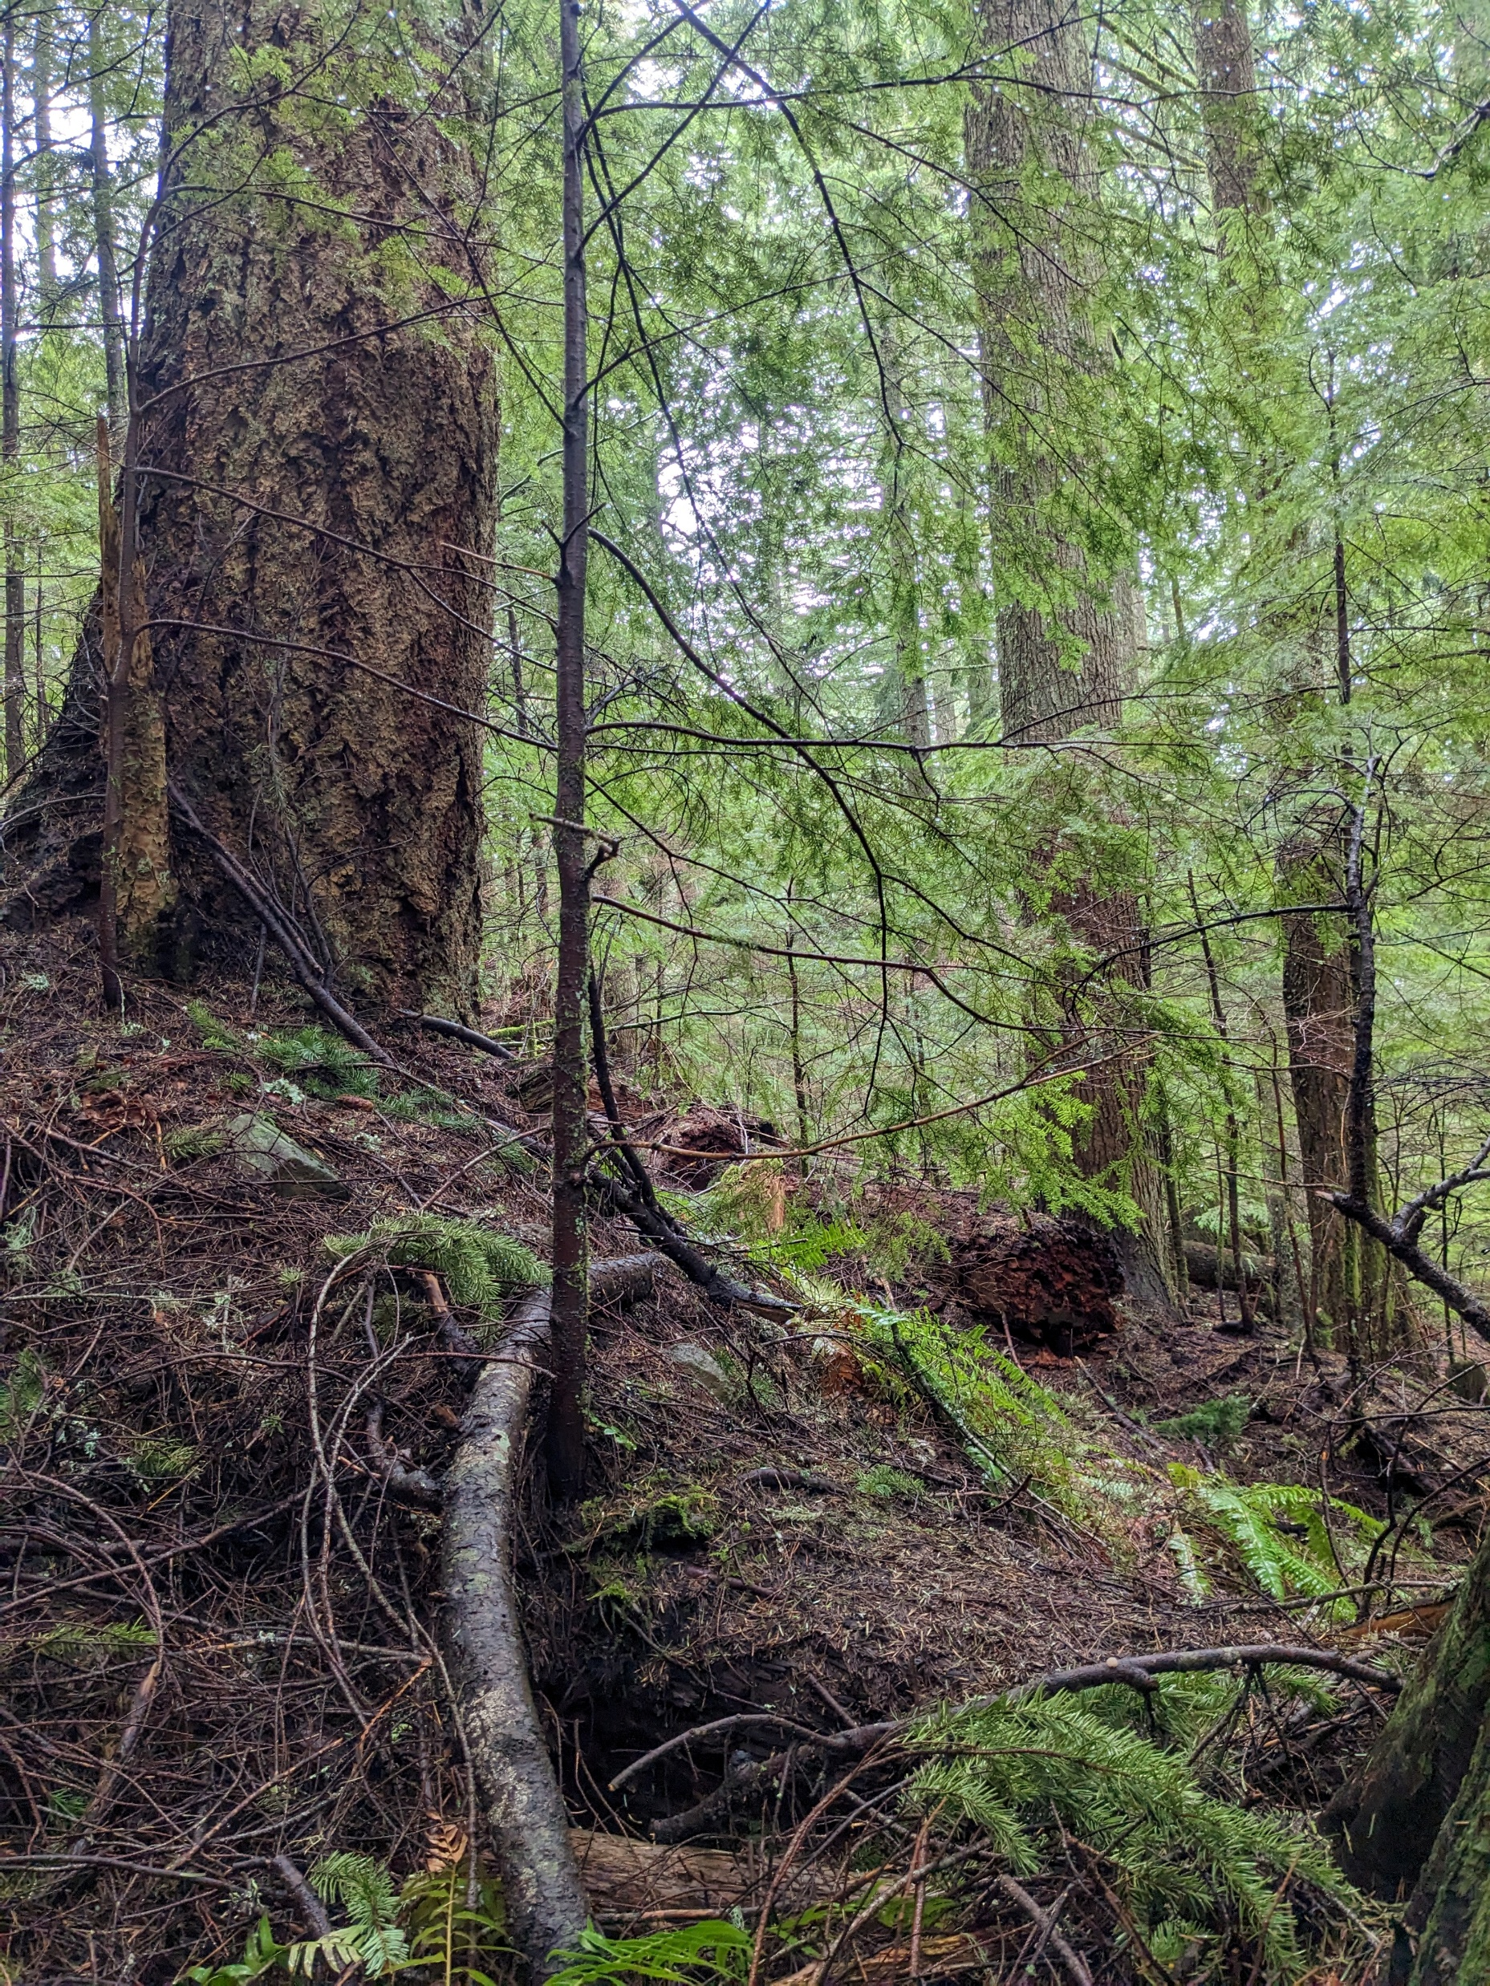
Photo by Richard hicks

Slide 3
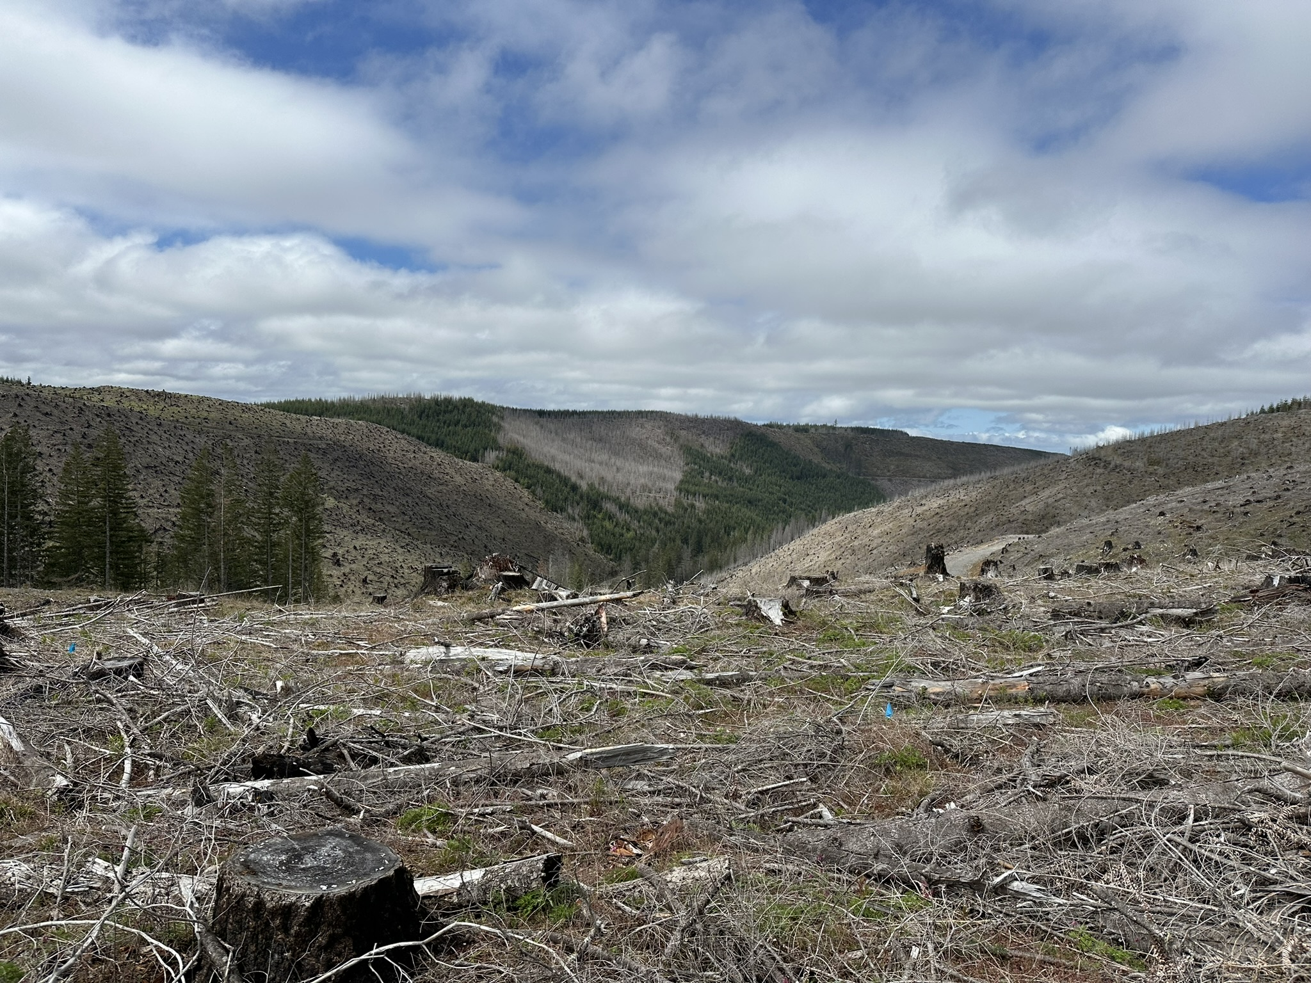
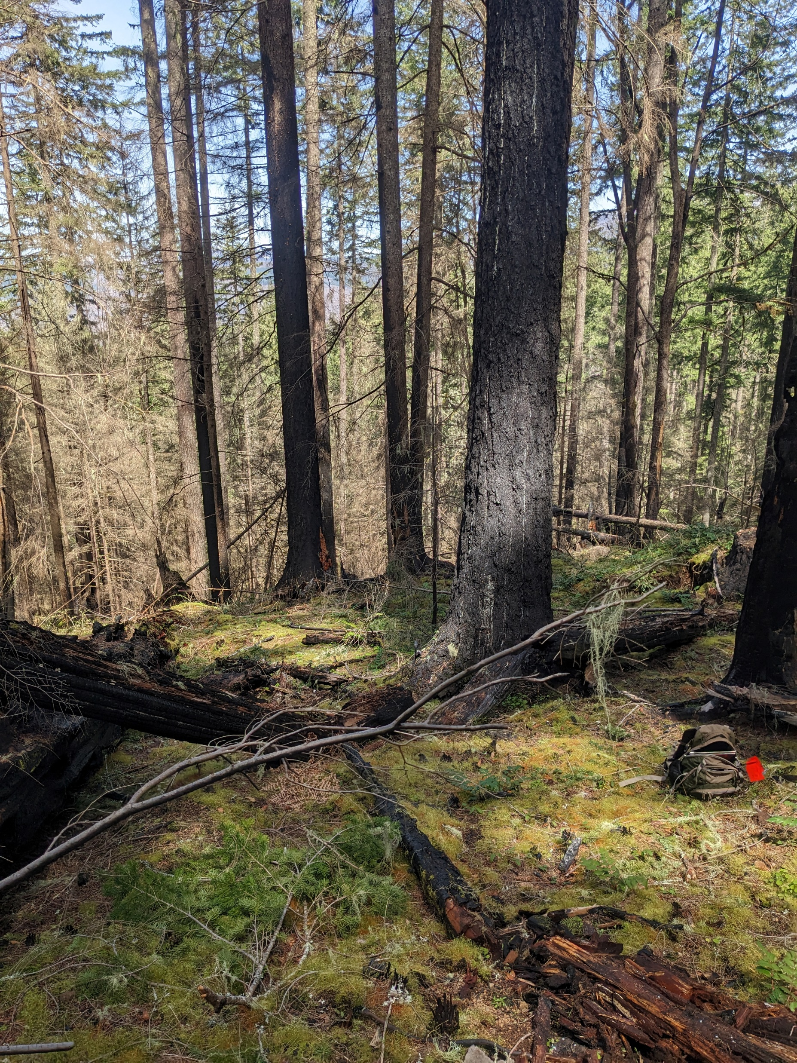
Notes:
Disturbances can alter microhabitat conditions

Slide 4
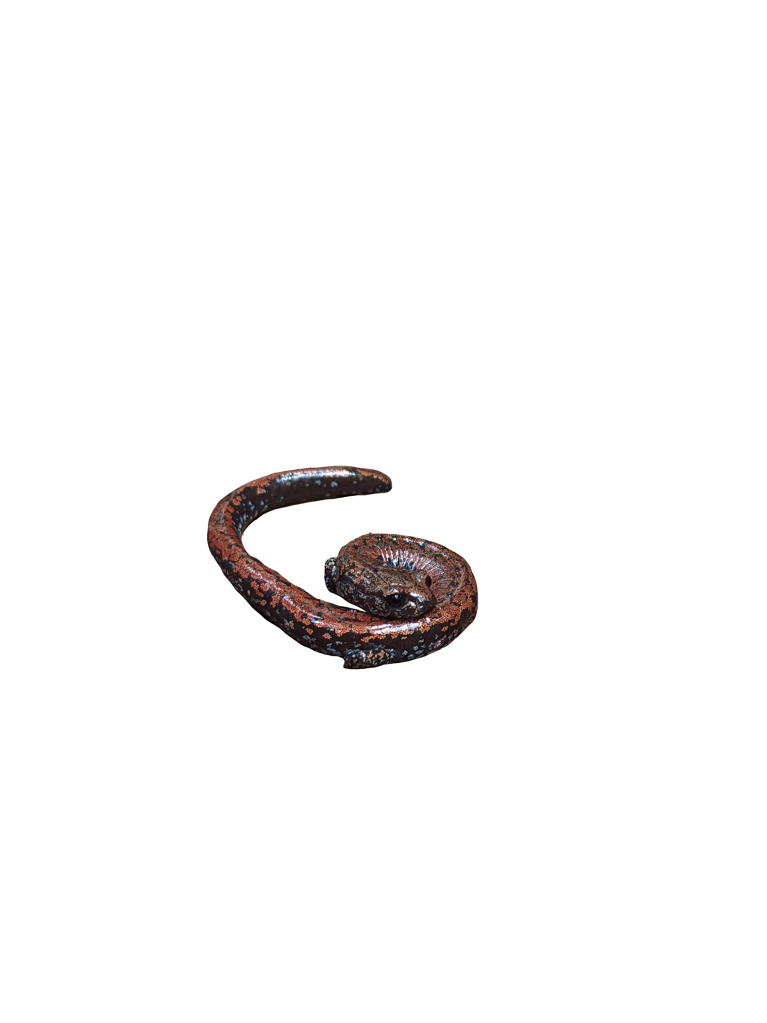
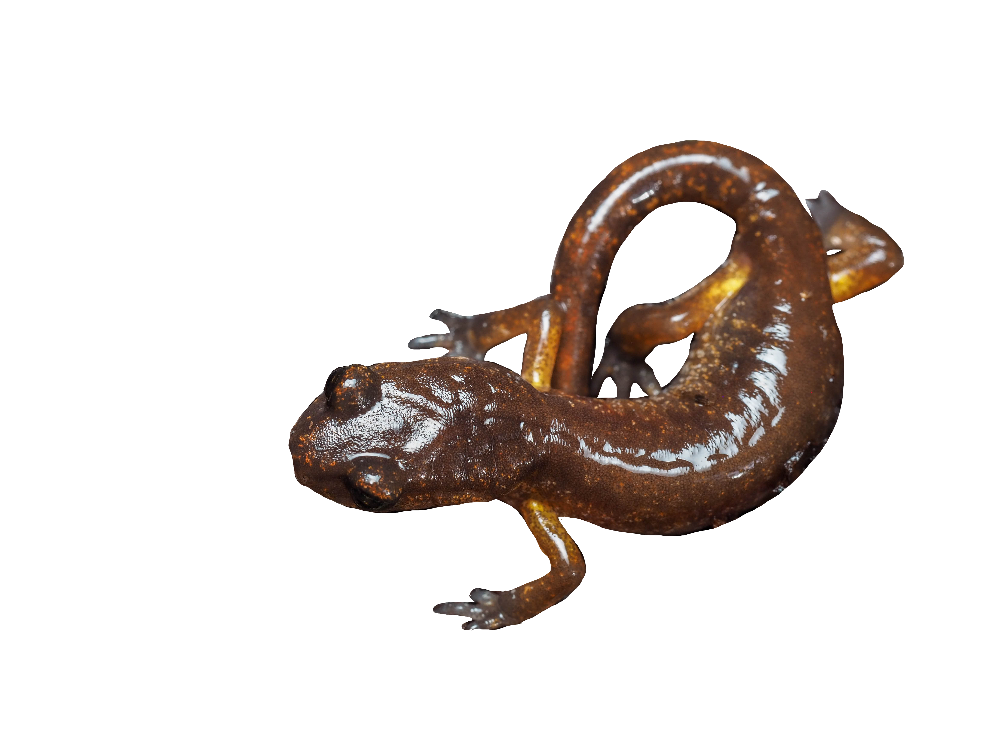
Oregon Slender salamander
Ensatina salamander
species status | Sensitive species (previously Imperiled/Vulnerable) | Generalist, widespread throughout the western US
home range | mid-elevation old- or second-growth forests of the Oregon Cascades | Broad, multiple microclimates
dispersal ability | Very small dispersal | Greater dispersal ability

Slide 5
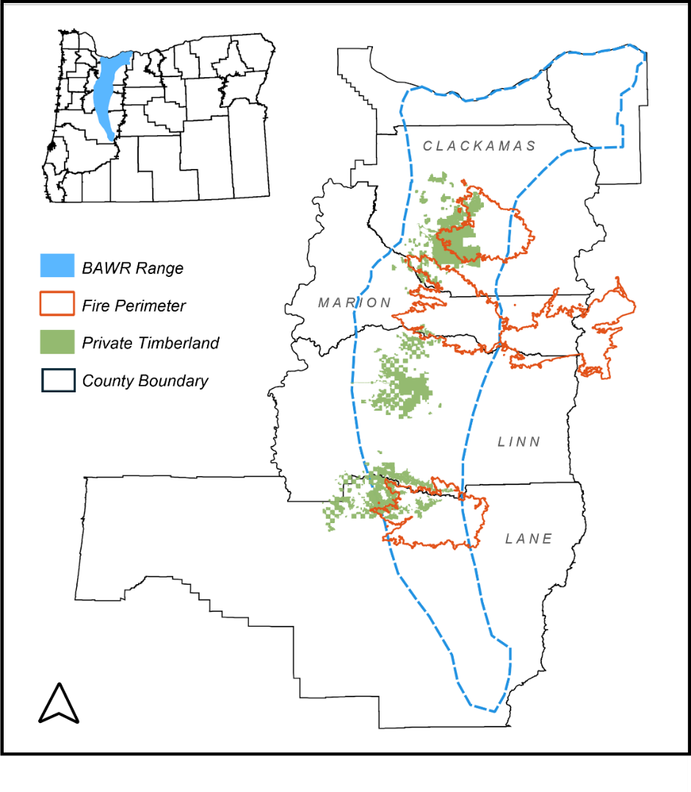
Oregon Slender salamander
Ensatina salamander
species status | Sensitive species (previously Imperiled/Vulnerable) | Generalist, widespread throughout the western US
home range | mid-elevation old- or second-growth forests of the Oregon Cascades | Broad, multiple microclimates
dispersal ability | Very small dispersal | Greater dispersal ability

Slide 6
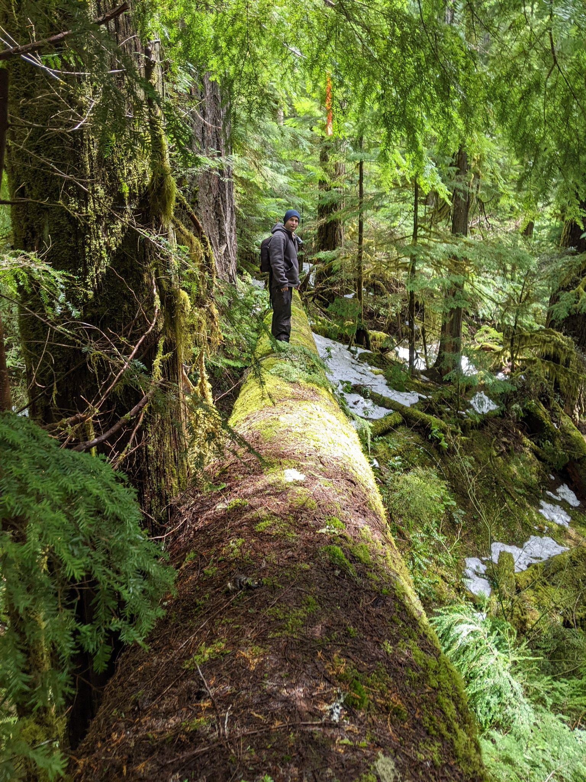
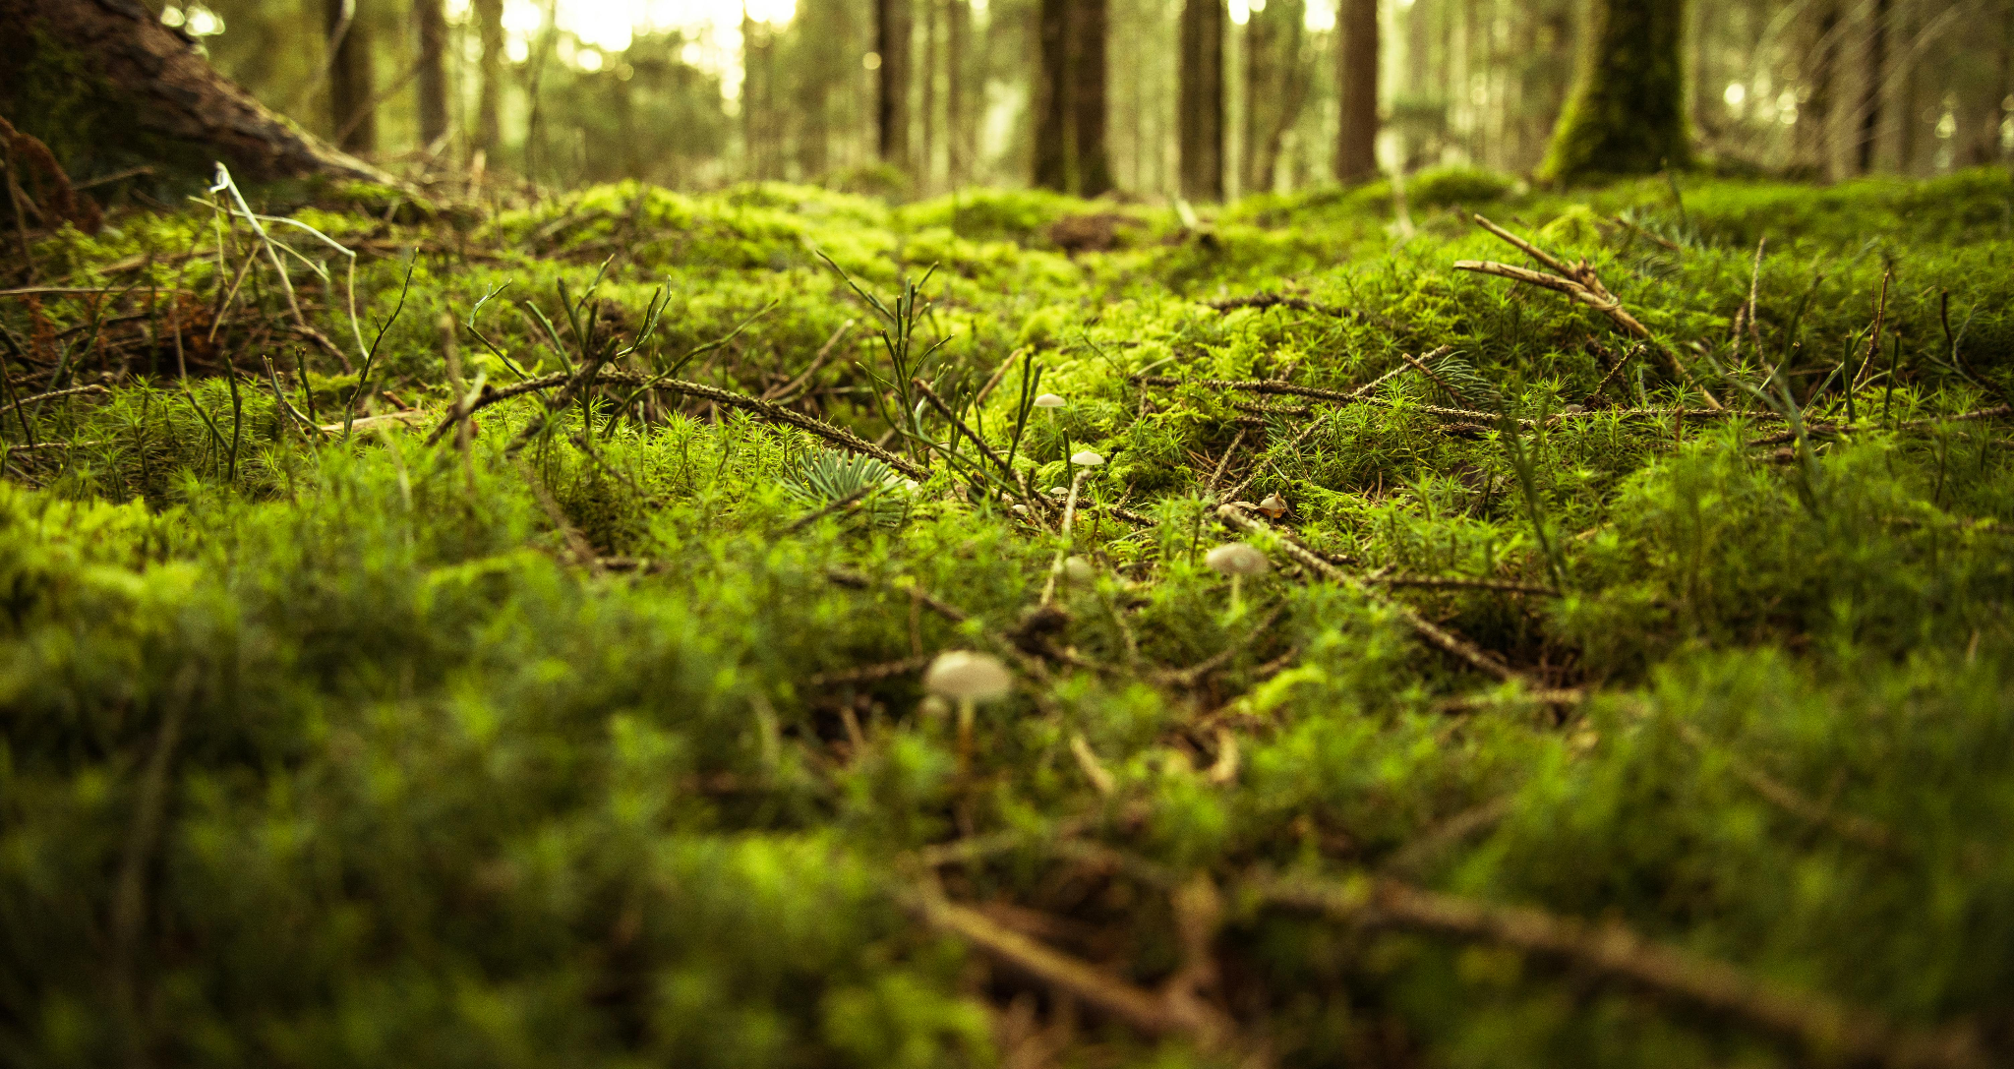
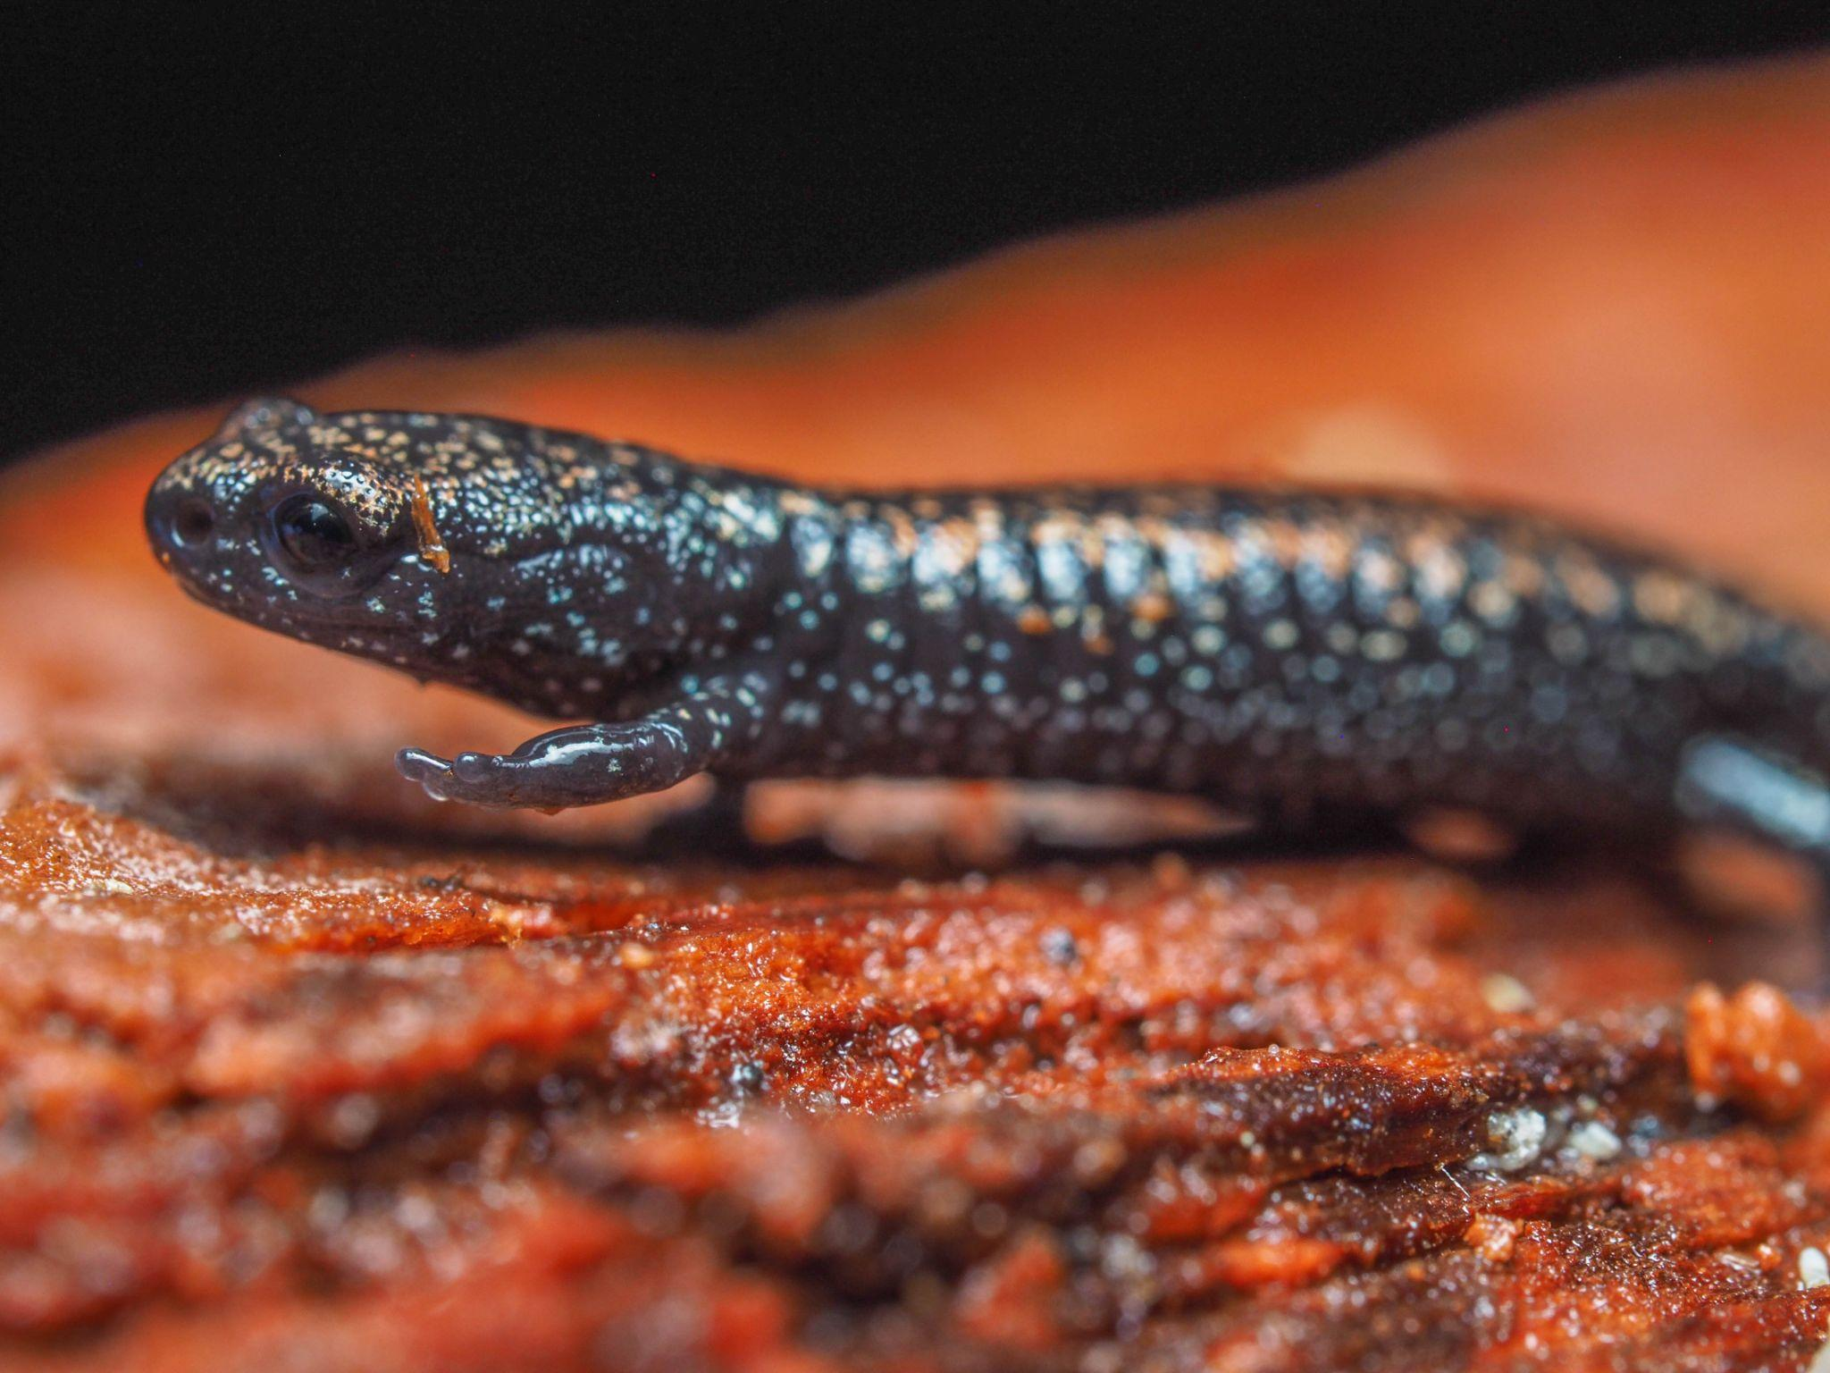
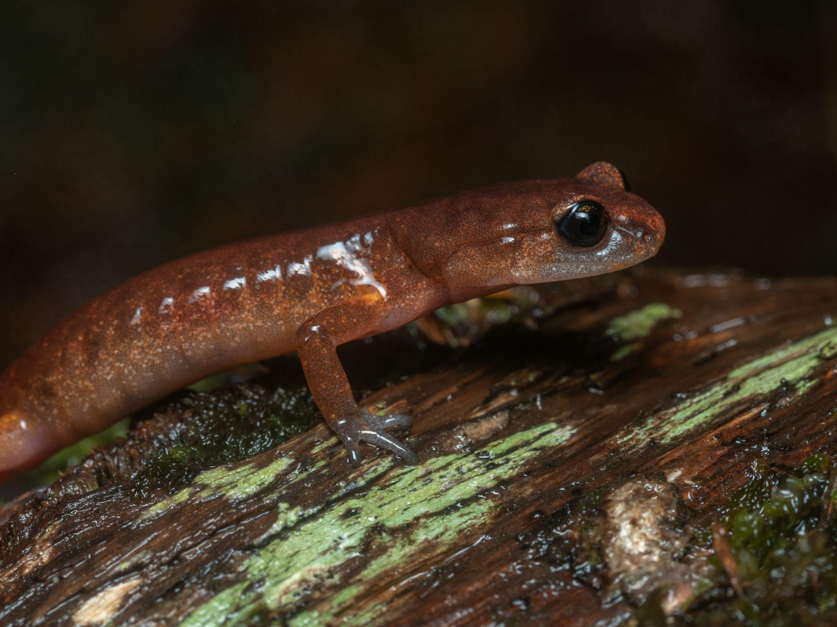
Salamanders need moist, cool environments

Slide 7
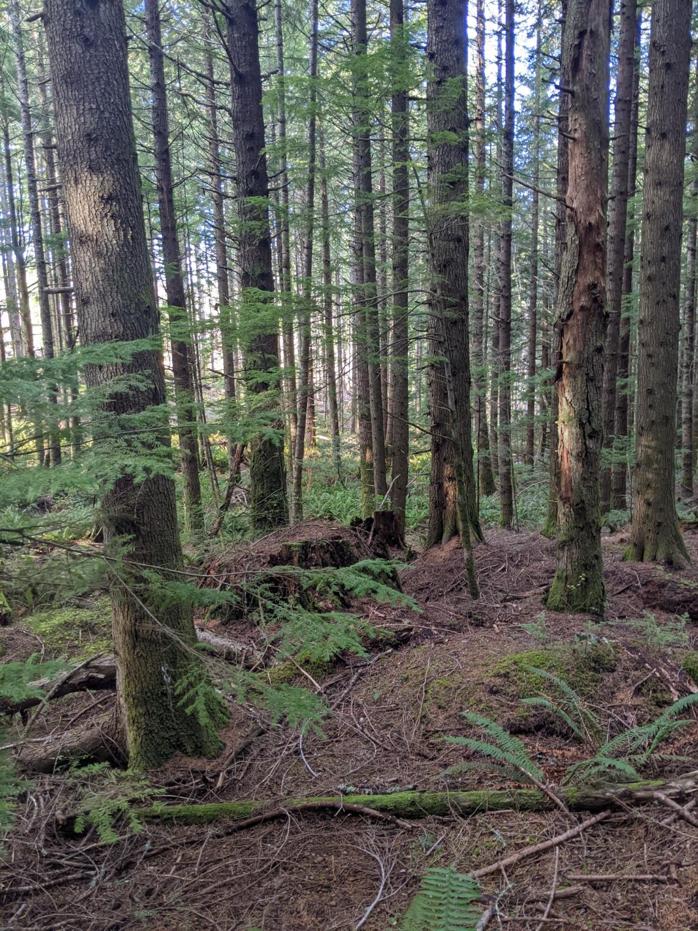
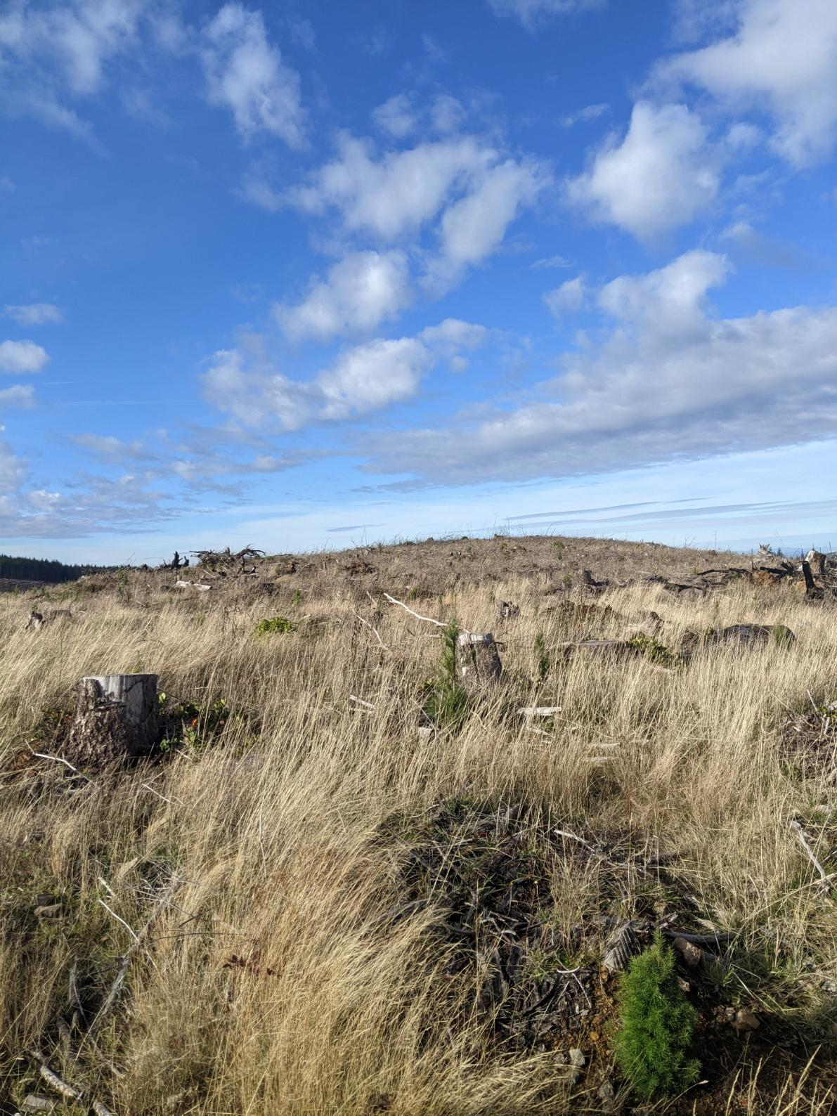
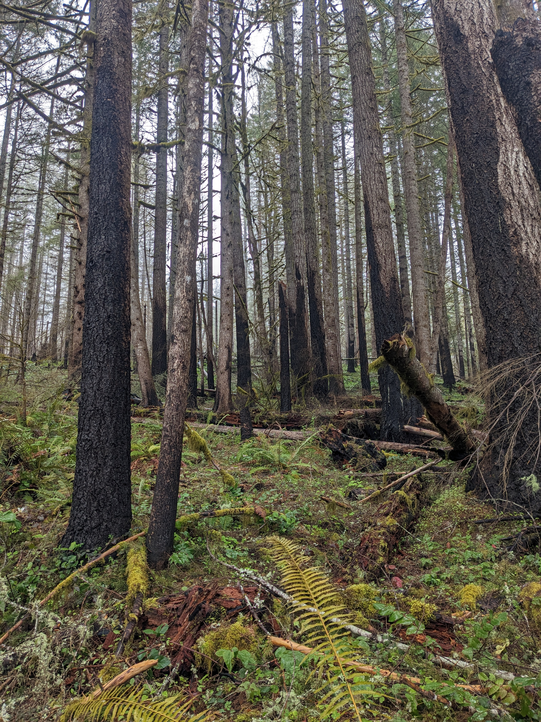
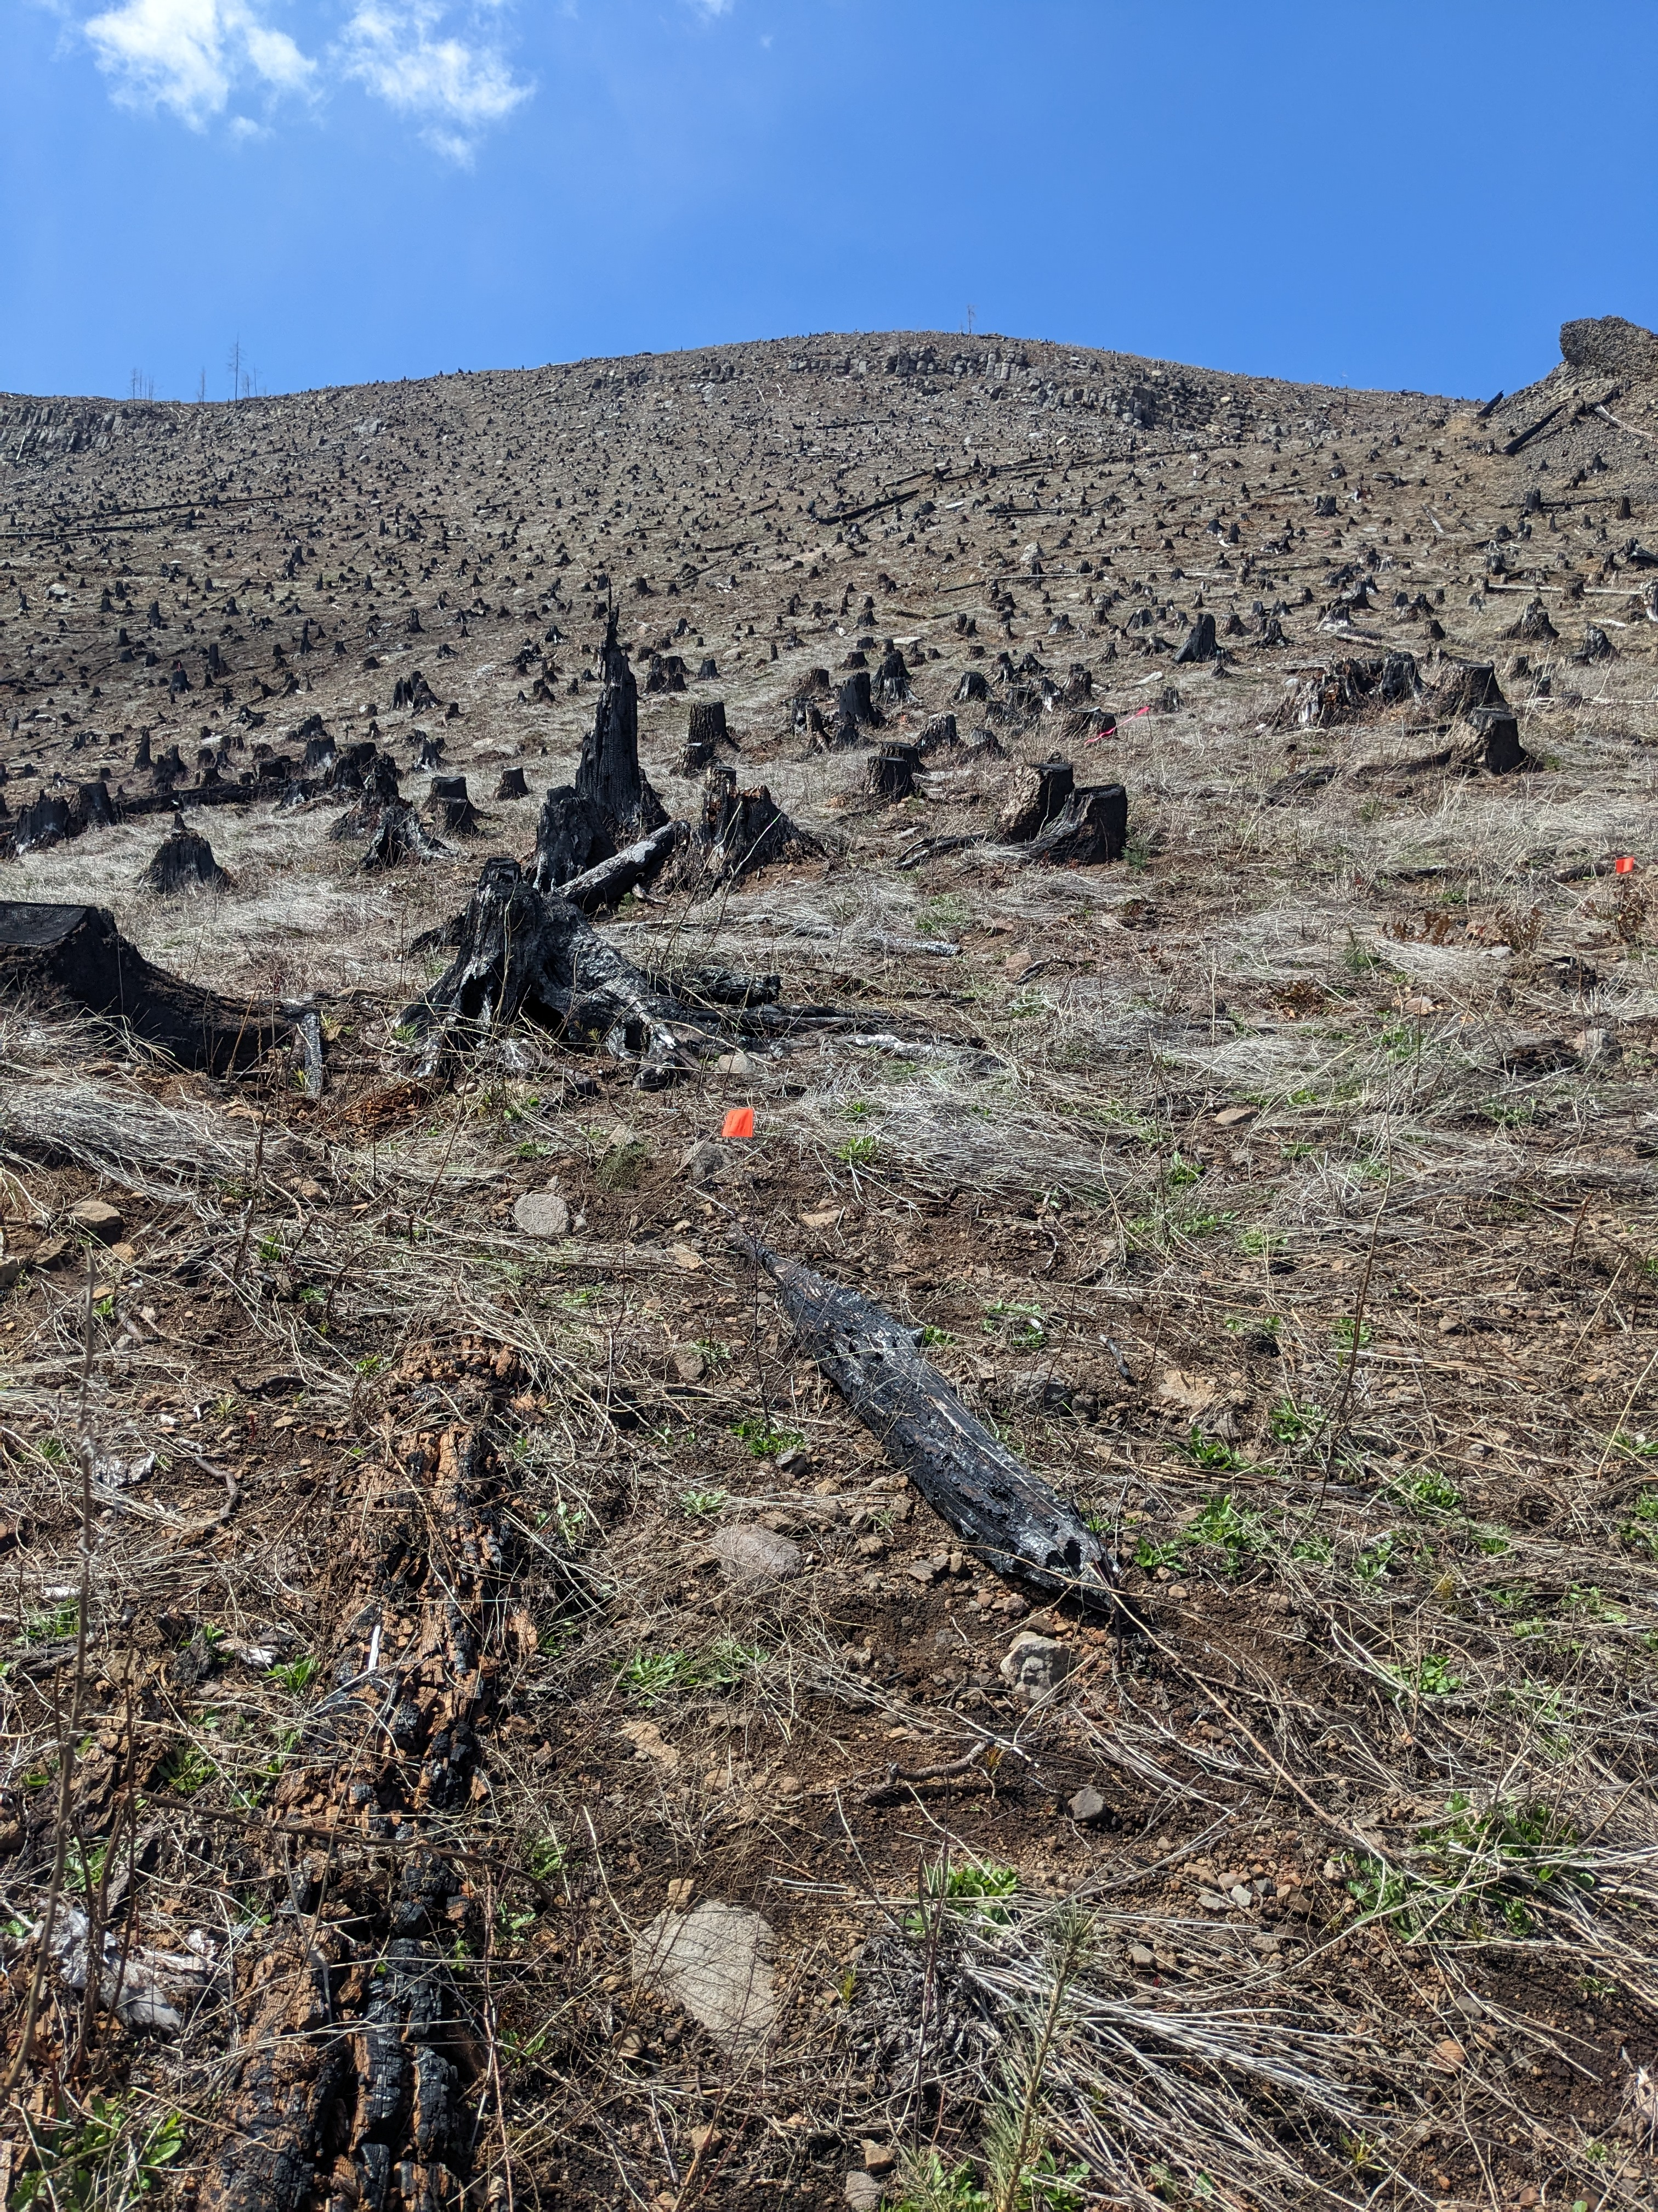
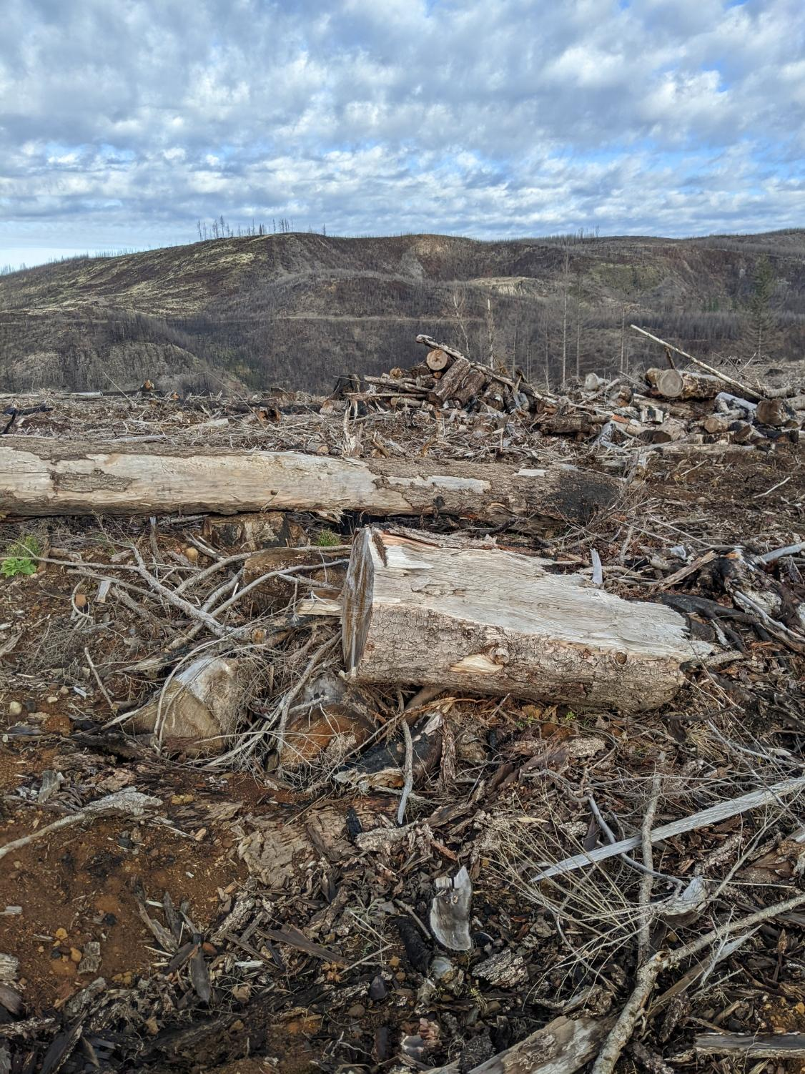
Treatments
Control (UU)
Harvest (HU)
Burned (BU)
Harvest, Burned (HB)
Burned, Salvage Logged (BS)

Slide 8
How does treatment impact microhabitat?
Which environmental variables are the primary drivers of salamander occupancy and abundance?
Questions

Slide 9
Treatment Characterization
What site-level environmental conditions characterize different treatment groups?
Ordination
Classify, characterize sites with environmental data
PCoA
More flexible with assumptions
tbRDA
Hellinger works with my spp data
Notes:
Characterizing sites based on habitat variables

Slide 10
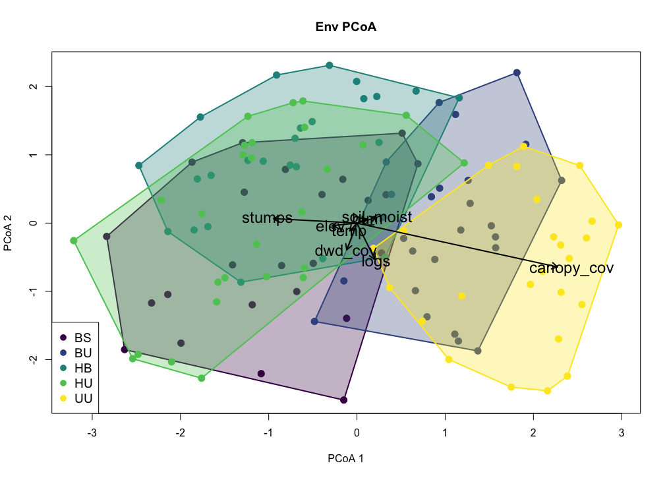
Principal Coordinates Analysis – Env Variables
Treatment Characterization
Notes:
Results: Present your main findings using figures, tables, or plots. Connect findings back to your objectives or hypotheses

Slide 11
Principal Coordinates Analysis – Env Variables
harvested
burned
control
Treatment Characterization
Notes:
Results: Present your main findings using figures, tables, or plots. Connect findings back to your objectives or hypotheses

Slide 12
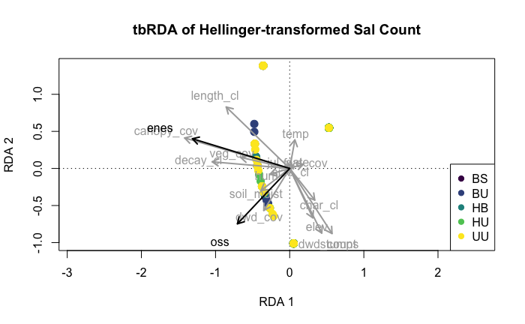
Transformation-based Redundancy Analysis
Treatment Characterization
Notes:
Results: Present your main findings using figures, tables, or plots. Connect findings back to your objectives or hypotheses

Slide 13
Drivers of Salamander Occupancy
How do environmental covariates, specifically downed wood metrics, influence salamander occupancy and abundance?
Classification tree
Random forest
OSS only!
Notes:
Describe the multivariate techniques you used and summarize how these methods were used to address your goals and objectives.

Slide 14
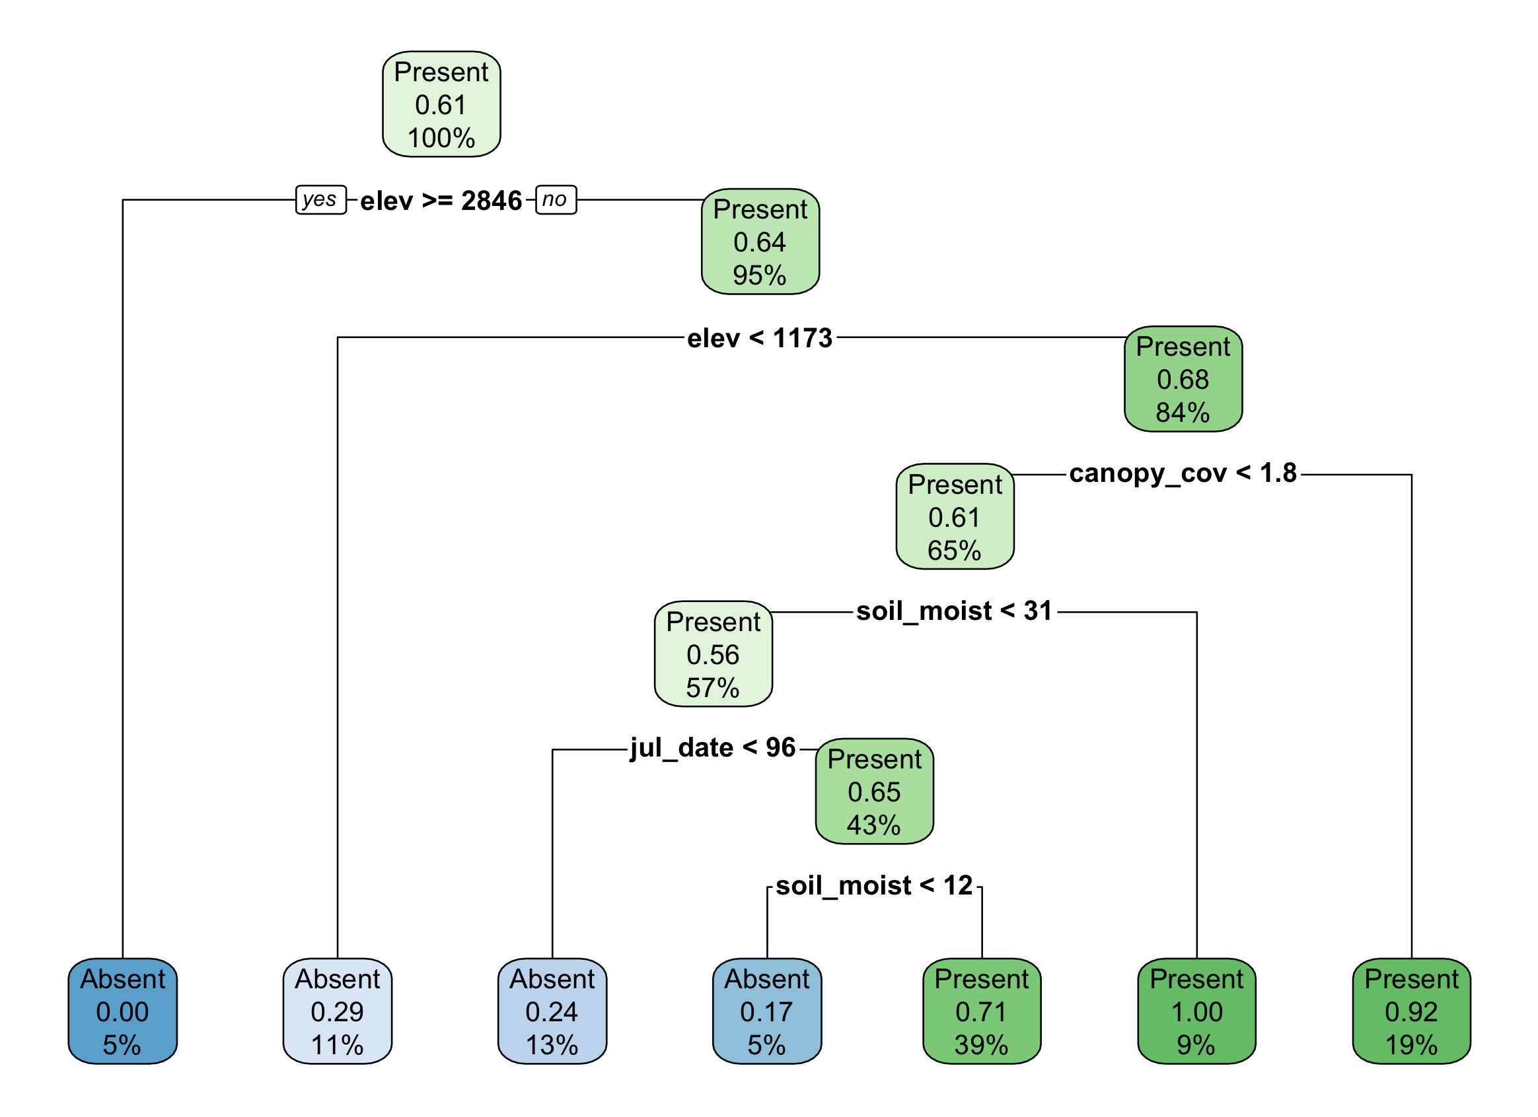
Classification Tree – Environmental Variables
Drivers of Salamander Occupancy
Notes:
Pruned 0.044

Slide 15
Classification Tree – Environmental Variables
Drivers of Salamander Occupancy
Notes:
Canopy cover is a direct measurement of harvest
We know theyre elevationally limited but not sure why that’s showing up as so important
Date is a proxy for weather conditions

Slide 16
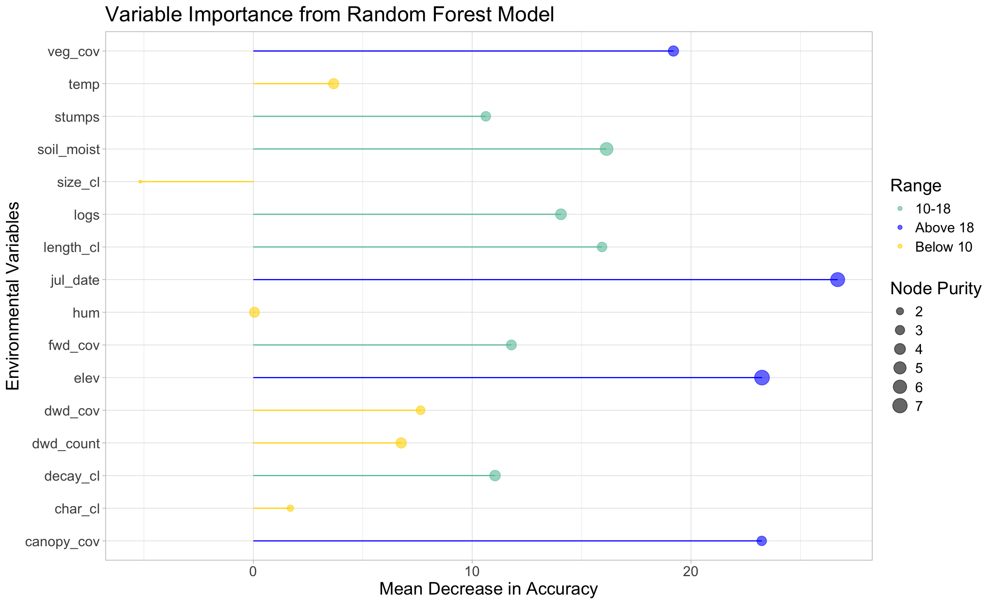
Random Forest – Top Predictors
Drivers of Salamander Occupancy
Notes:
Results: Present your main findings using figures, tables, or plots. Connect findings back to your objectives or hypotheses
Node purity measures how well a variable splits data into homogeneous groups. Higher values indicate that a variable effectively reduces impurity (e.g., mixing of classes) in decision tree splits. In random forests, it's a proxy for variable importance.
Mean Decrease in Accuracy is used to evaluate the importance of a predictor, quantifies how much the model's prediction accuracy decreases when the values of a specific feature are randomly shuffled. A larger decrease in accuracy indicates that the feature is important for making accurate predictions. A smaller decrease suggests the feature is less important.

Slide 17
Random Forest – Top Predictors
Drivers of Salamander Occupancy
Notes:
Highest
Canopy cover is a direct measurement of harvest
We know theyre elevationally limited but not sure why that’s showing up as so important
Date is a proxy for weather conditions
Veg cover is unexpected, maybe a good way to tease out disturbances

Slide 18
Random Forest – Top Predictors
Drivers of Salamander Occupancy
Notes:
Medium importance
Mostly wood related
Stumps, logs
Decay class and length would tell us about treatment
Fwd cover, ground cover
Soil moisture is something we hypothesized would be really important for sallies

Slide 19
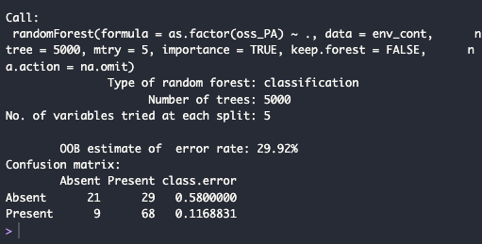
Random Forest
Drivers of Salamander Occupancy
Notes:
Canopy cover is a direct measurement of harvest
We know theyre elevationally limited but not sure why that’s showing up as so important
Date is a proxy for weather conditions
Veg cover is unexpected, maybe a good way to tease out disturbances

Slide 20
Calculate downed wood metric
Investigate specific variables
Relationships for occupancy models, GLM
Next steps
Notes:
Broader Implications: Interpret your findings in the context of ecological theory or applied man- agement

Slide 21
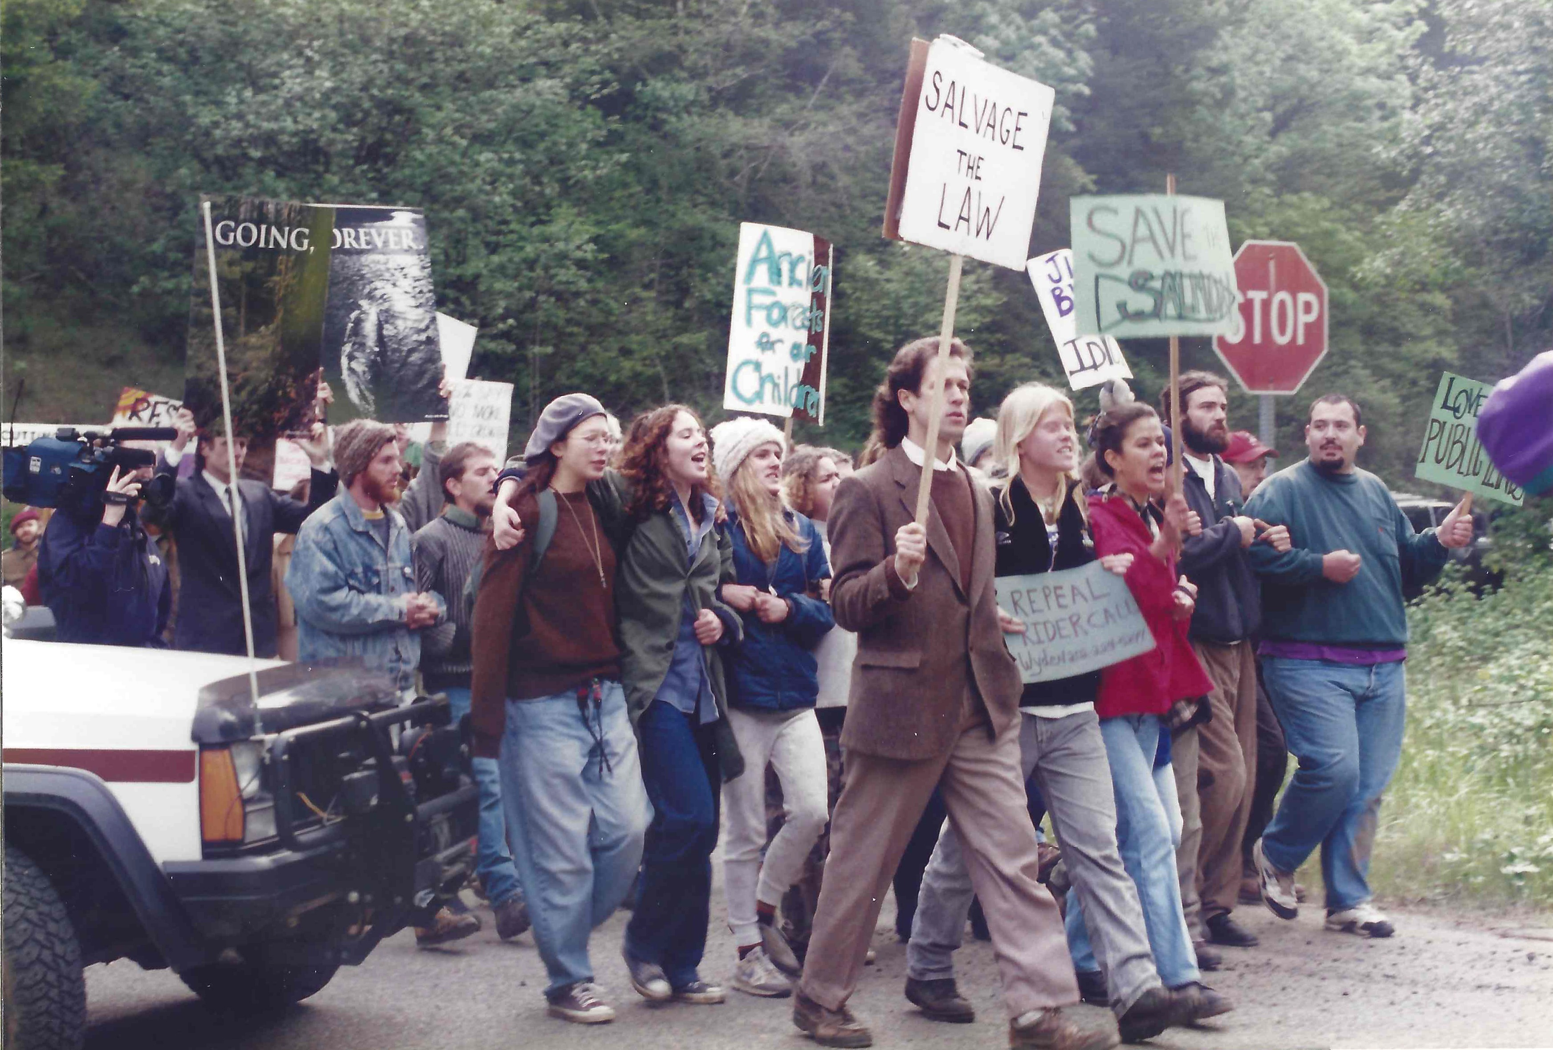
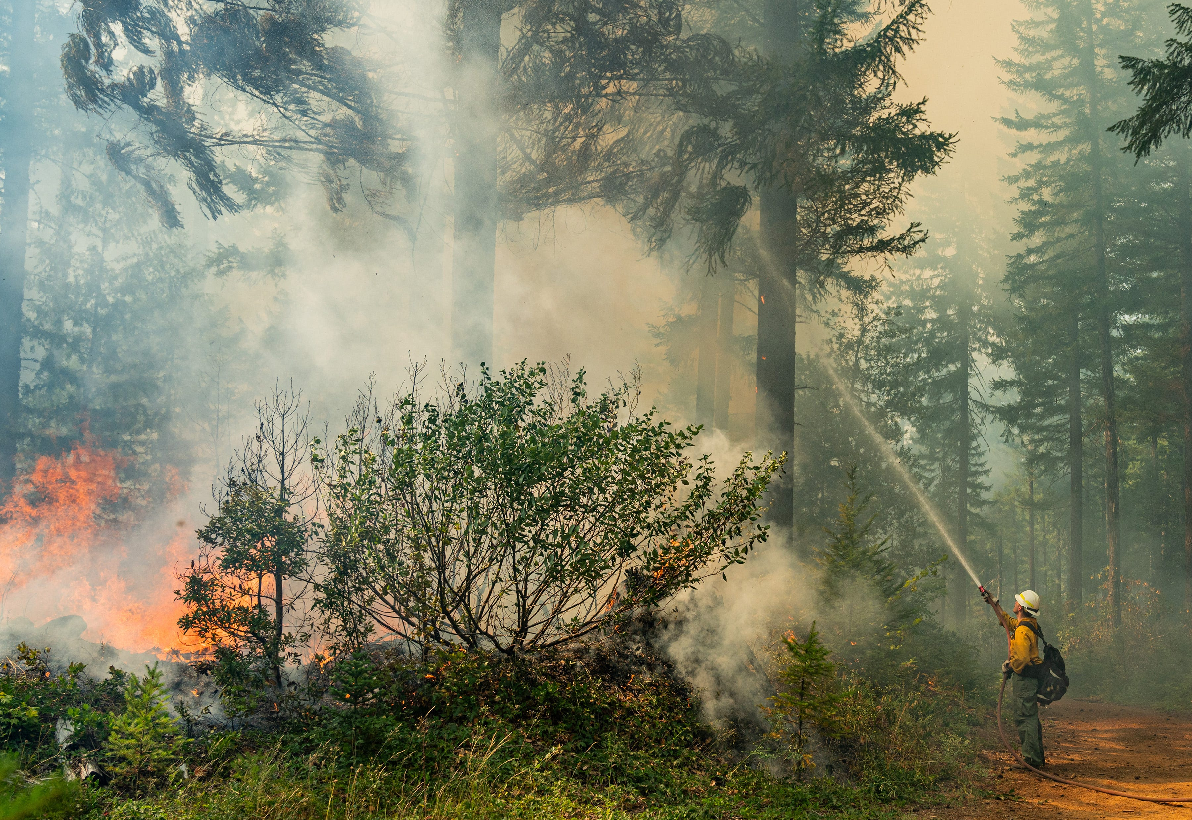
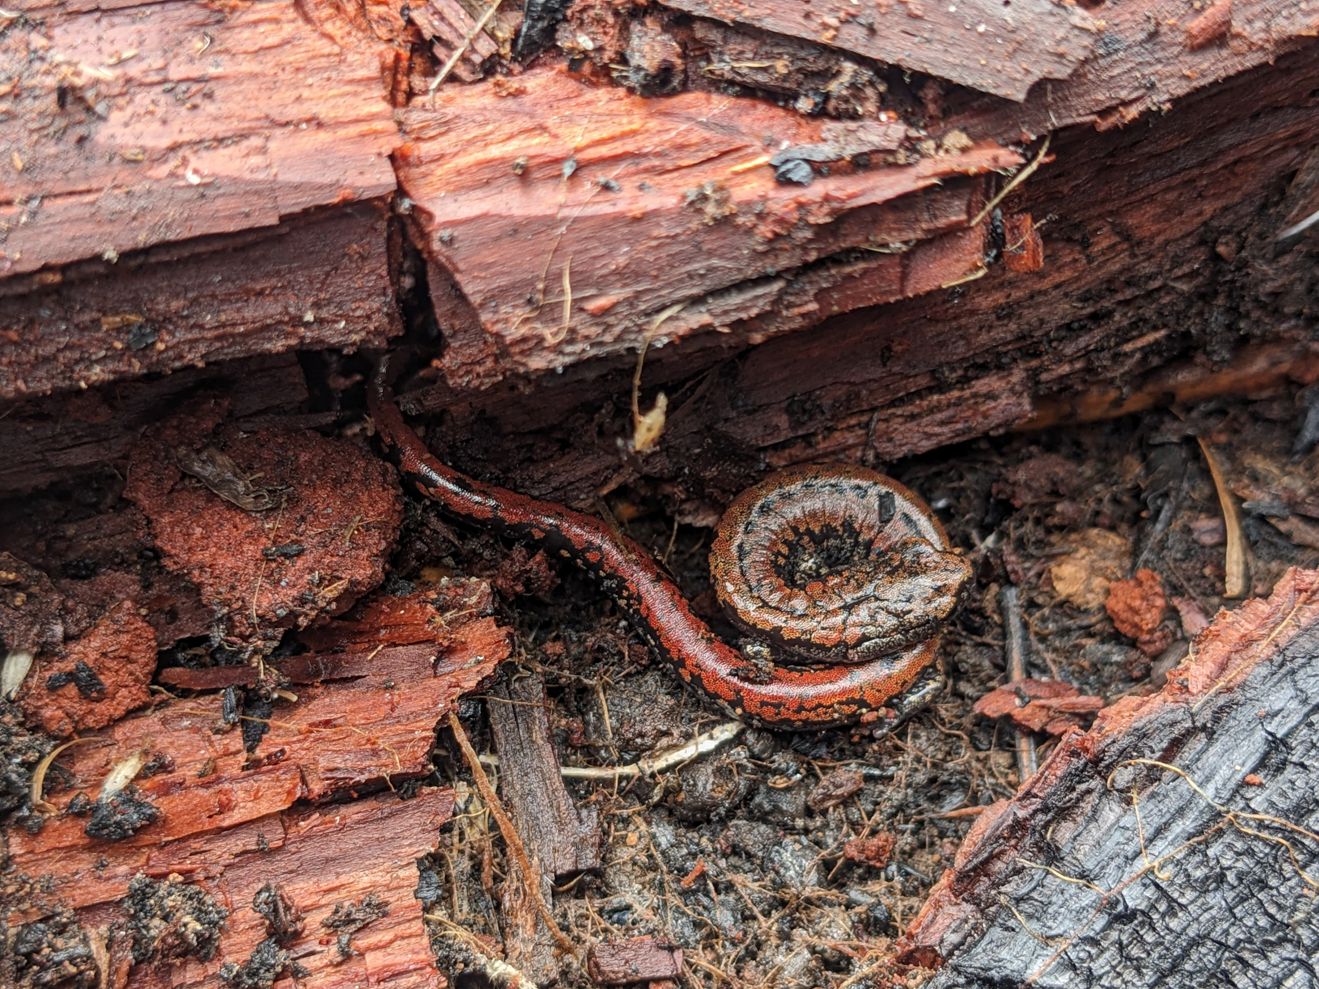
Looking forward: What does this mean for forest health, wildlife, managers, and communities?
Notes:
This complex combination of disturbances causes issues from the forest floor level to the community level, and the goal of this project is to help management understand how the wildlife and forest habitat are impacted under this new disturbance regime

Slide 22
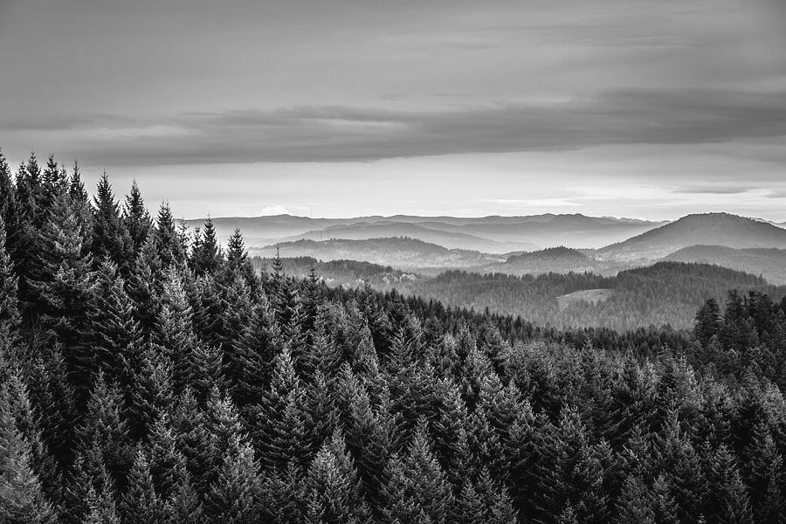
Thank You!

